Slide 1

Smart Ride-Hailing System A Digital Public Good for Sierra Leone PROG 102 - Principles of Software Engineering Group [2] Date: [Presentation Date
Name:
Alpha Rahman Sesay
Jospeh Vandy
Solomon

Slide 2
INTRODUCTION
Introduction
Problem Statement
Informal transportation system
Unpredictable fares
Safety concerns
Limited accountability
Lack of digital payment integration

Slide 3

Project Justification Why this project?
Formalizes transportation
Improves passenger safety
Supports local drivers
Encourages digital payments
Promotes sustainable urban mobility

Slide 4
Alignment with UN SDG 11 Sustainable Cities and Communities
Our system contributes by:
Optimizing urban mobility
Reducing traffic congestion
Lowering fuel consumption
Improving passenger safety
Supporting economic growth
Encouraging digital inclusion

Slide 5
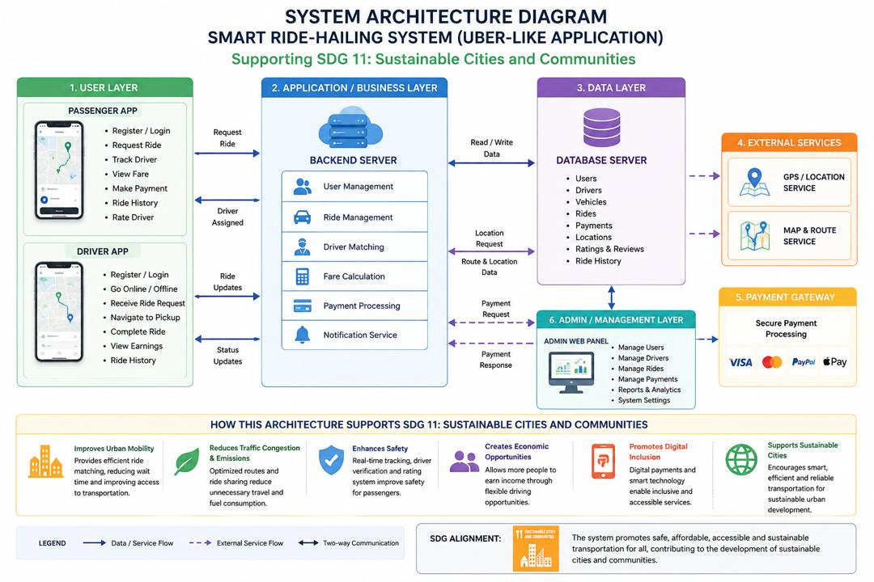
System Architecture Overview
5-Layer Architecture:
User Layer
Business Layer
Data Layer
External Services
Admin Layer

Slide 6
How the System Works Ride Booking Process
Passenger requests a ride.
Backend calculates route and fare.
System searches for nearby drivers.
Driver accepts request.
GPS tracking begins.
Passenger pays through Mobile Money.
Admin monitors transactions.

Slide 7
Project Management - Gantt Chart
Project Phase & Core Tasks | Weeks | W1 | W2 | W3 | W4 | W5 | W6 | W7 | W8 | W9 | W10
Phase 1: Research & UI/UX Design (Tasks A & B: Planning & Figma Specs) | W1 - W3 | 🟩 | 🟩 | 🟩
Phase 2: Core Engineering & Data (Tasks C & D: Architecture & MySQL) | W3 - W4 |  |  | 🟩 | 🟩
Phase 3: Integration & Frontend Build (Tasks E, F & G: Backend, App, APIs) | W5 - W7 |  |  |  |  | 🟩 | 🟩 | 🟩
Phase 4: Validation & Deployment (Tasks H, I, J & K: QA, Admin Web, Release) | W8 - W10 |  |  |  |  |  |  |  | 🟩 | 🟩 | 🟩
Weeks 1-2 Requirements
Weeks 3-4 Architecture & DB
Weeks 5-7 Development
Weeks 8-9 Testing
Week 10 Deployment

Slide 8
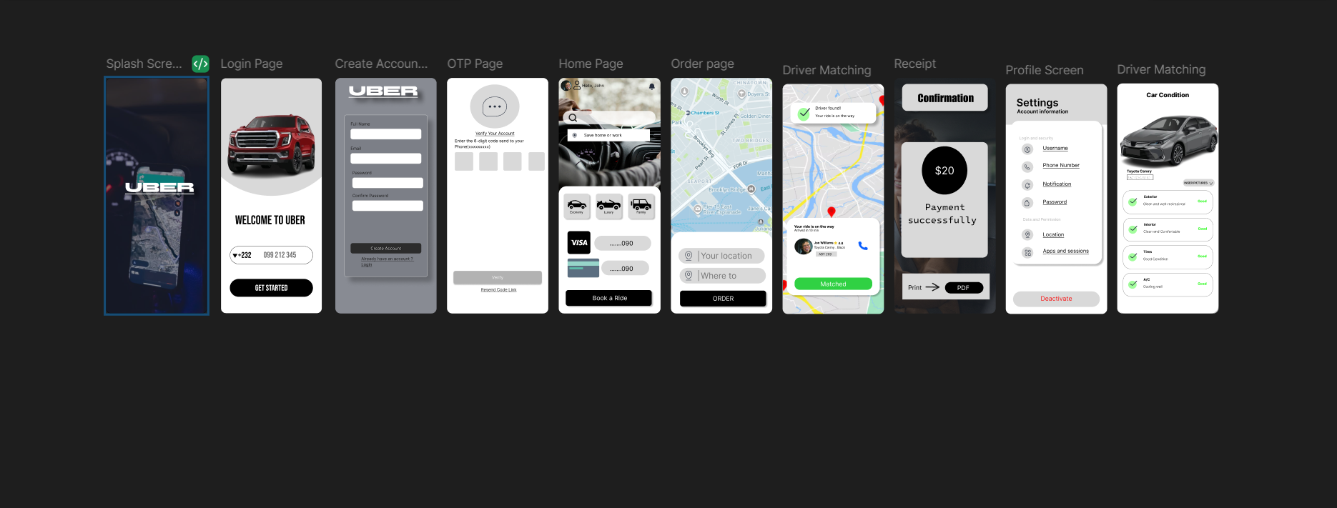
Prototype Screens (UI/UX)
Splash Screen
Login
OTP
Home Map
Request Ride
Tracking
Payment
Confirmation
Profile
Car Condition

Slide 9
Key Features
GPS Location Tracking
Driver Verification
Real-Time Driver Matching
Fare Calculation
Mobile Money Payments
Digital Receipts
User Ratings
Profile Management

Slide 10
Benefits
For Passengers
Safe transportation
Transparent pricing
Shorter waiting time
Cashless payment
For Drivers
Flexible income
More customers
Fair rating system
For Government
Better transport management
Improved data collection
Supports smart city initiatives

Slide 11
Conclusion
Summary
Solves transportation challenges in Sierra Leone.
Supports Sustainable Development Goal 11.
Uses scalable layered architecture.
Provides secure and transparent ride-hailing services.
Promotes digital inclusion and economic growth.

